Slide 1
Xeebec Networks

Slide 2
Group Member
Hasnain Iftekhar (21-Arid-578)
Arslan Afzal (21-Arid-557)
Noman Amjad (21-Arid-654)

Slide 3
Company Introduction
It is a xeebec IT creative - work-place company held in Rawalpindi . This company works on different fields web or software developing , Call center that can sell cars insurance. This company also do the insurance of different things like life insurance ,house insurance etc.
In this a lot of network tools is using. A lot of switch ,router and PC are connected by different ways and manage by different ways.
All the system,router,switch are used in this company is HP brand . The 30 to 40 PC are used at same time they connected with different switch and routers. The switch used by this company has 24 ports.

Slide 4
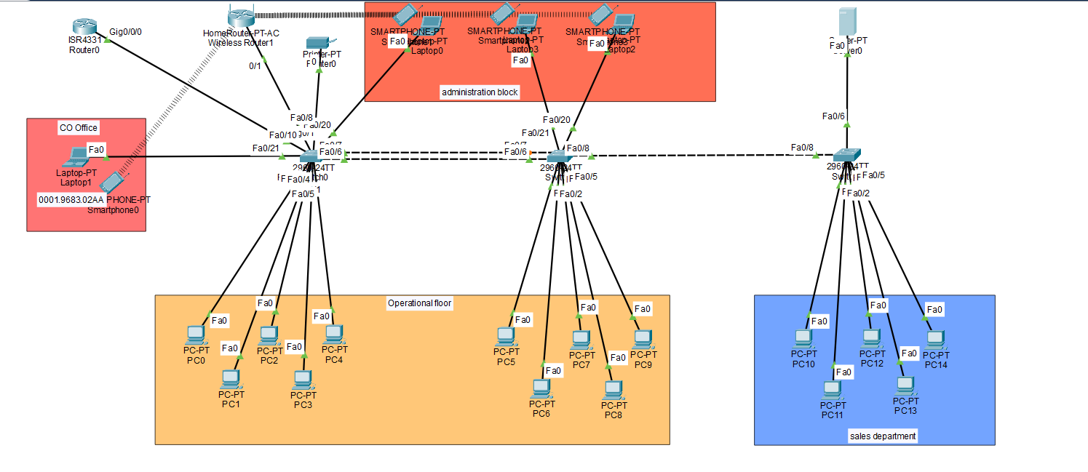
Our design network for Xeebec

Slide 5
Router Configurations.
Change host name and configure enable password on it.
Configure static IP
Configure dhcp lan network on it
Configure remote access configuration on it
Configure server backup on it
Reserve some IP from dhcp.
Create a banner of router
Configure a RIP(router internet protocol) for vlan

Slide 6
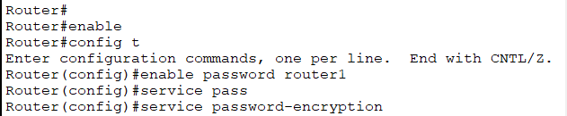

Hostname, banner and enable password

Slide 7
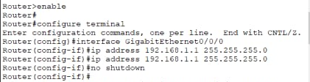
STATIC IP CONFIGURATIONS

Slide 8
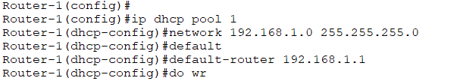
DHCP configurations

Slide 9
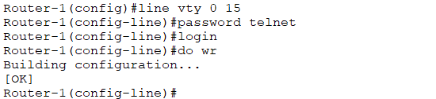
Configuration for remote access

Slide 10
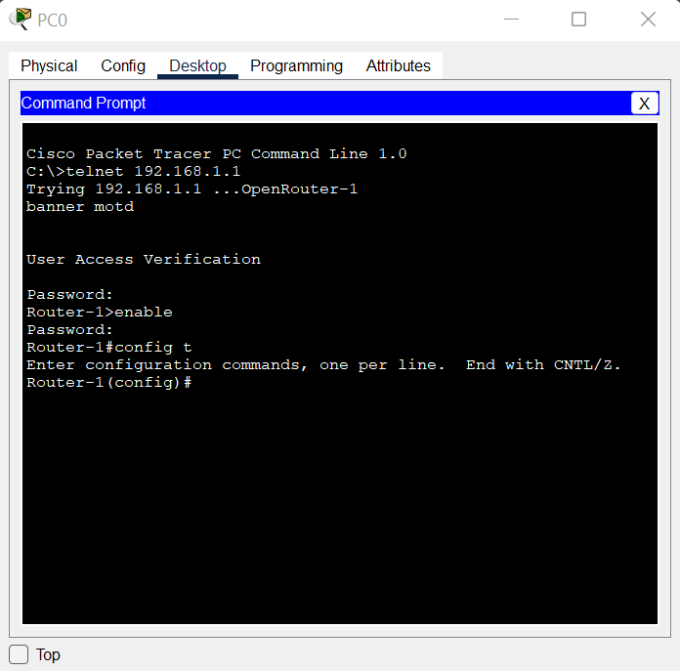
Output for remote access

Slide 11
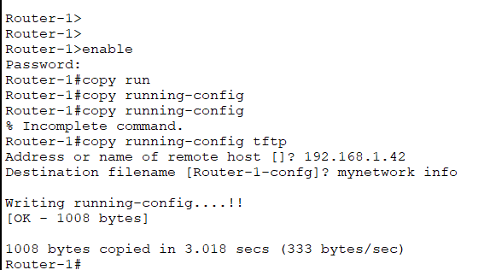
Configuration backup on server

Slide 12
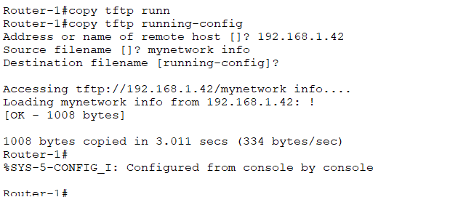
Recover backup

Slide 13

IP reserve from DHCP

Slide 14
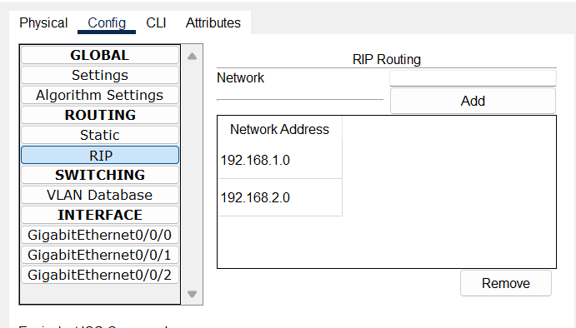
RIP Configuration

Slide 15
Switch-1 configuration
Create a host name and set password
Create a switch banner
Configure a port banding on switch
Configure a vlan

Slide 16
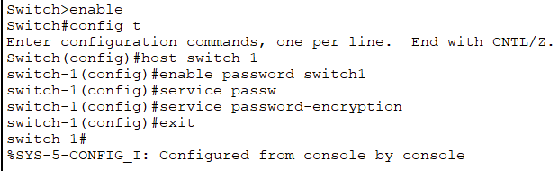
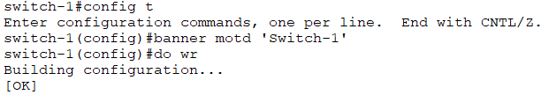
Hostname, banner and password

Slide 17
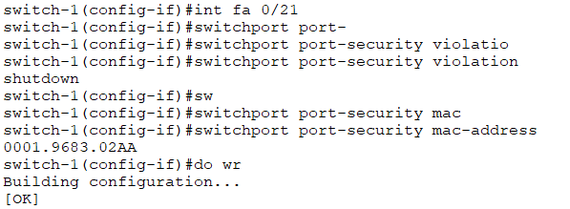
Port banding

Slide 18
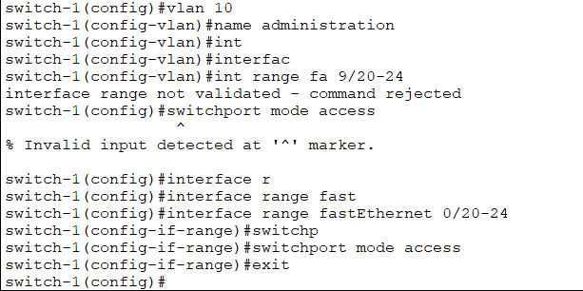
Vlan configuration

Slide 19
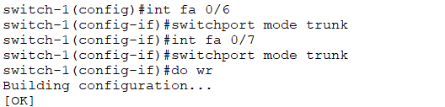
Configuring trunk ports

Slide 20
Switch-2 configurations
Hostname and password configuration
Set banner
Create vlan

Slide 21
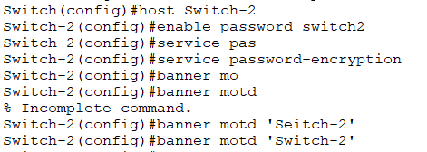
Password and banner

Slide 22
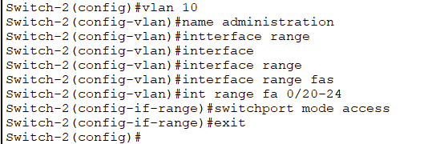
Create Vlan

Slide 23
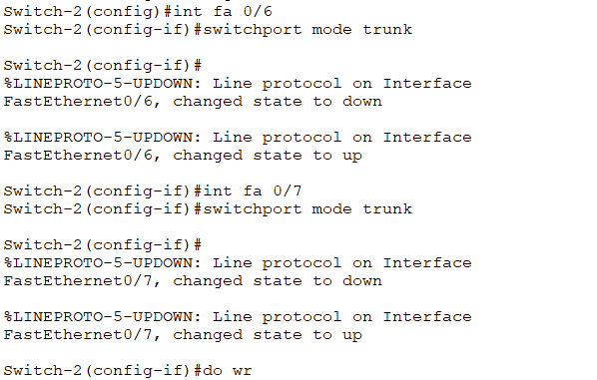
Trunk port

Slide 24
Switch-3
We only configure a password, hostname and banner on swtich-3 as a switch1 or 2.

Slide 25
Computers configurations
We assign dynamic IP in the computer.
Vlan Computer are connected with each other through a static IP

Slide 26
Server and printer
Server are used for backup configurations and also for data
Printer are connected with static ip with operation floor and accounting department

Slide 27
Home router
Home router are used for smartphone wifi and also smart tv etc.
It is connect with switch-1 and assign a dynamic IP.

Slide 28
The End

